Slide 1



Logic Model Exercise for BSK Expanded Learning Initiative

Slide 2
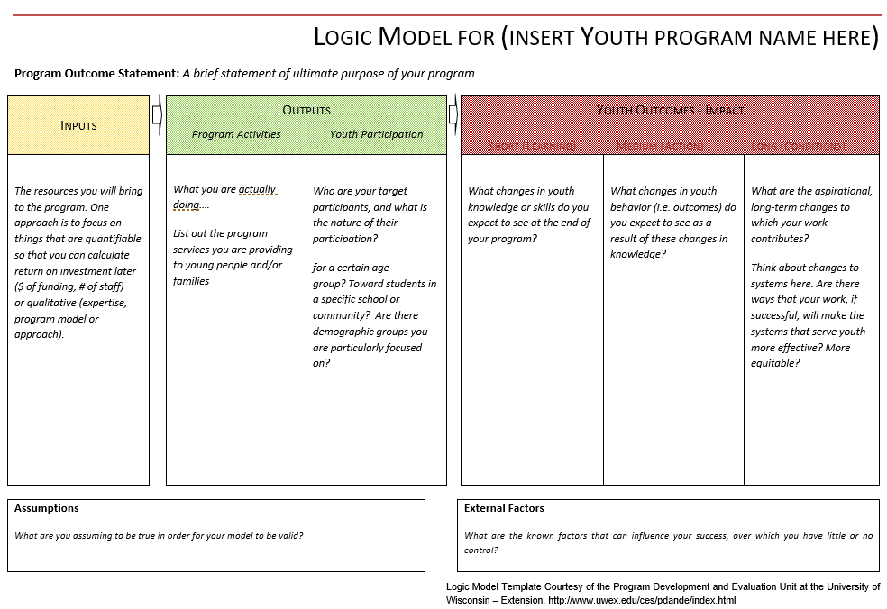
Program Design Exercise for Best Starts for Kids Expanded Learning Programs – Linking Activities to Outcomes

Slide 3
Place-Based Collaboratives – Partnership Components
After defining youth activities and outcomes in the Program Logic Model, add a layer of partnership to your design if you are doing this work in collaboration with others.
Partnership Outcome Statement: A brief statement of the shared, high-level purpose of the partnership (aligned with the Program Outcome Statement, but not the same)
Inputs |  | Outputs |  |  | Outcomes - Impact
 |  | Program and Partnership Activities | Program and Partnership Participation |  | Short (Learning) Medium (Action) Long (Conditions)
The resources you will bring to the program and to the partnership; Also think about partner resources that your program will use. Will you be sharing space or supplies, or relying on a data sharing agreement? |  | What you are actually doing… Consider including the activities that you will direct toward sustaining the partnership. Are there regular meetings? Joint trainings? | Who are your target (adult) participants, and what is the nature of their participation? |  | What changes in adult knowledge or skills that you expect to occur as a result of program or partnership activities? | What changes in adult behavior do you expect to see? | What are the aspirational, long-term changes to which your work contributes? Think about changes to systems here. Are there ways that your work, if successful, will make the systems that serve youth more effective? More equitable?

Slide 4
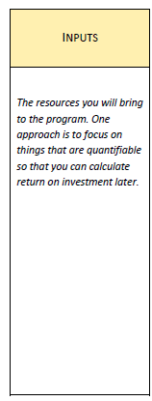
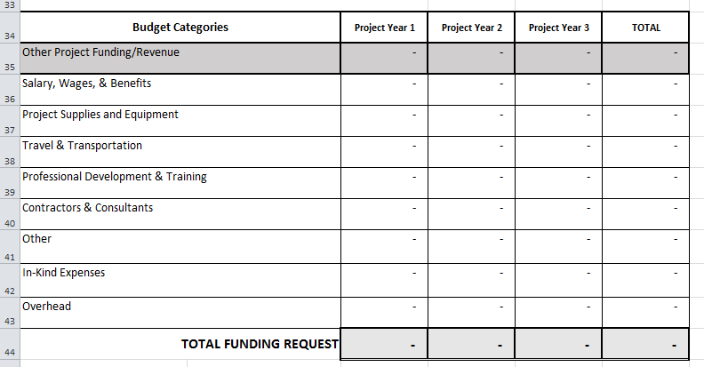
What assets will you bring to this work?
For your Partnership/Organizational Overview, think about…
Your strengths as an organization
Your existing or potential partnerships
Your participation in, or readiness for, quality improvement work
For your Budget…

Slide 5
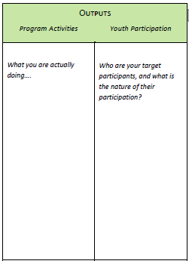
What do you propose to offer, for whom, and how much?
For BIPOC-led organizations:
Describe the racial, ethnic and/or cultural community(ies) on which your organization focuses its work. Detail how many children and youth your organization currently serves, the locations of your current programs, and the types of programming provided.
For Place-Based partnerships:
Detail how many children and youth each of the partner
organizations currently serve, their demographics, the locations of your current programs, and the types of programming provided. Provide demographic information on the children and youth your Place-Based Partnership intends to serve.
In your Narrative, be as specific as possible about…
Which activities will be available to participants
Who will provide these activities
The dosage that will be offered
Be aware of minimum dosage requirements (these differ for BIPOC-led versus Place-Based Partnerships)

Slide 6
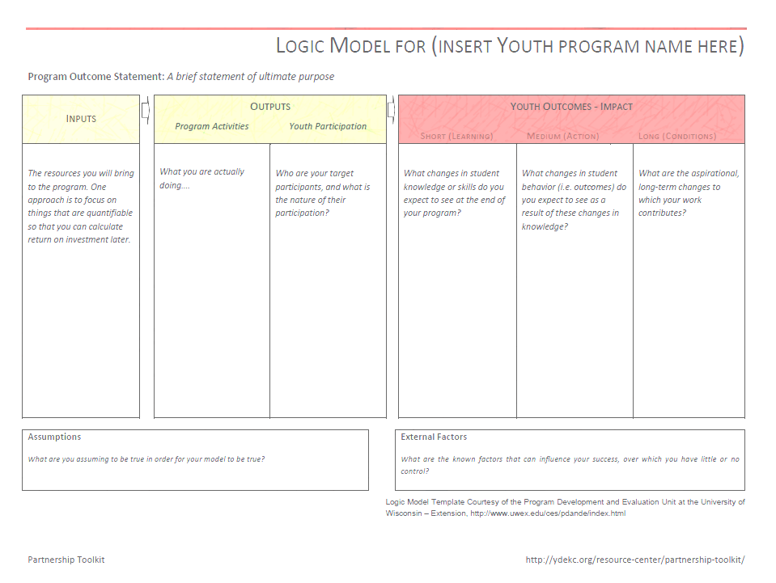
What are the outcomes you are working toward?
What is the ultimate goal of your program or partnership?
How will you know if you are making progress in your program?
How does your work address BSK secondary indicators?
o Lowering the rate of adolescent births
o Youth who have supportive adults
o Youth believe in their ability to succeed
o Youth are not chronically absent from school
o Youth are getting good grades in school
o Youth are completing 9th grade
o Young adults participate in civic activity and are engaged
o Youth are not justice system involved
o Youth have positive social-emotional development
o Youth are not suspended/expelled from school
o Youth are physically active
o Youth have strong family relationships
o Youth have strong peer relationships
o Youth have strong school relationships
o Youth live in supportive neighborhoods
o Youth and young adults are successful beyond school or employment
What about BSK headline indicators?
o 3rd graders who meet reading standard
o 4th graders who meet math standard
o Youth who are flourishing and resilient
o Youth and young adults who are in excellent or very good health
o Youth who graduate from high school on time
o Youth and young adults in school or working
o High school graduates who earn a college degree or career credential
o Youth not using illegal substances

