Slide 1
Building Sustainable School-Community Partnerships & Programs

Slide 2

Welcome to "Building Sustainable School-Community Partnerships & Programs!"
Please type into the chat box:
Name and pronouns
Organization
What’s something in your life that has been long-lasting and what made it that way?

Slide 3

School & Community Partnership Toolkit
Logic Model Template
Partnership Charter Planning Tool
Tip Sheet: Preparing for an Initial Partner Meeting
Data to Practice Protocol
Partnership Ecosystem Mapping Activity
Image: Clckr-Free-Vector Images (Pixabay)
Evaluation Planning Worksheet
Youth Program Partnership Newsletter Guide

Slide 4
Learning Objectives
Define
Define sustainability using 5 domains
Identify
Identify practices to strengthen sustainability
Assess
Assess areas of strength and areas in need of development, and take steps to prepare a sustainability action plan

Slide 5
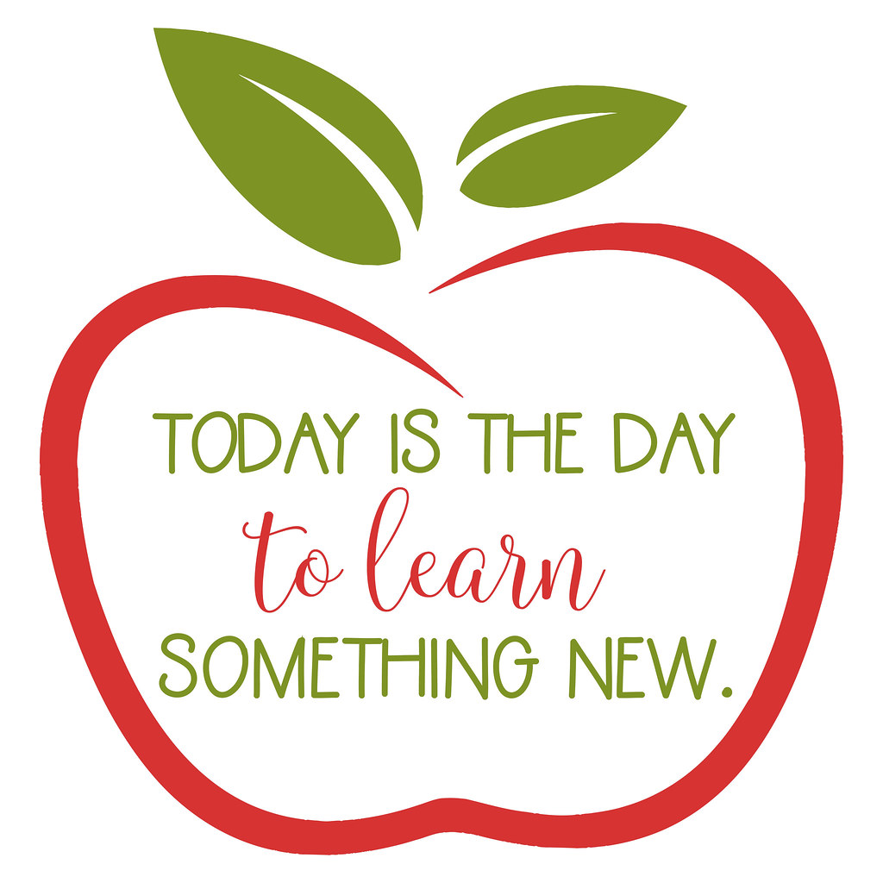
Setting the stage
Learn with and from each other
Participate in activity & discussion (Let us know if your circumstances require that you to be a passive participant)
Cameras on when possible
Offer grace
Use "raise your hand" feature or "unmute" to speak
Contribute ideas or questions in the chat box
Low-tech – Have a writing utensil and pieces of paper near you for activities during today's session.
This Photo by Unknown author is licensed under CC BY-ND.
Notes:
Change to in person norms, housekeeping. Kelly and Kintasha to update.

Slide 6
"Capable of being prolonged; to withstand"
Domains of sustainability
Relationships
Strategic Communication
Program & Partnership Quality
Resource Development
Documentation

Slide 7

Sample strategies for...
Relationships
Do a school and community Partnership Ecosystem Mapping Activity
Take steps to share power & decision-making, such as using the Shared Decision-Making Planning Tool
Expand who knows whom

Slide 8

Sample strategies for...
Strategic communication
Invite partners to contribute input and develop a shared vision using a Sample Vision Process for Partnerships
Craft a communication strategy that matches your target audience(s)
Find out what your potential or current partners value, and communicate how you are aligned

Slide 9

Sample Strategies for...
Documentation
Create a Memorandum of Understanding using the Tip Sheet for Creating a MOU
Document what you do
Create a folder with shared access
Use multiple mediums to tell your story

Slide 10

Sample strategies for... program & Partnership Quality
Choose an area of growth to work on together
Use the Partnership Meeting Topics & Sample Agenda for regular check-ins that include reciprocal feedback
Use the Tip Sheet for Equitable Meetings to build more authentic and collaborative spaces

Slide 11
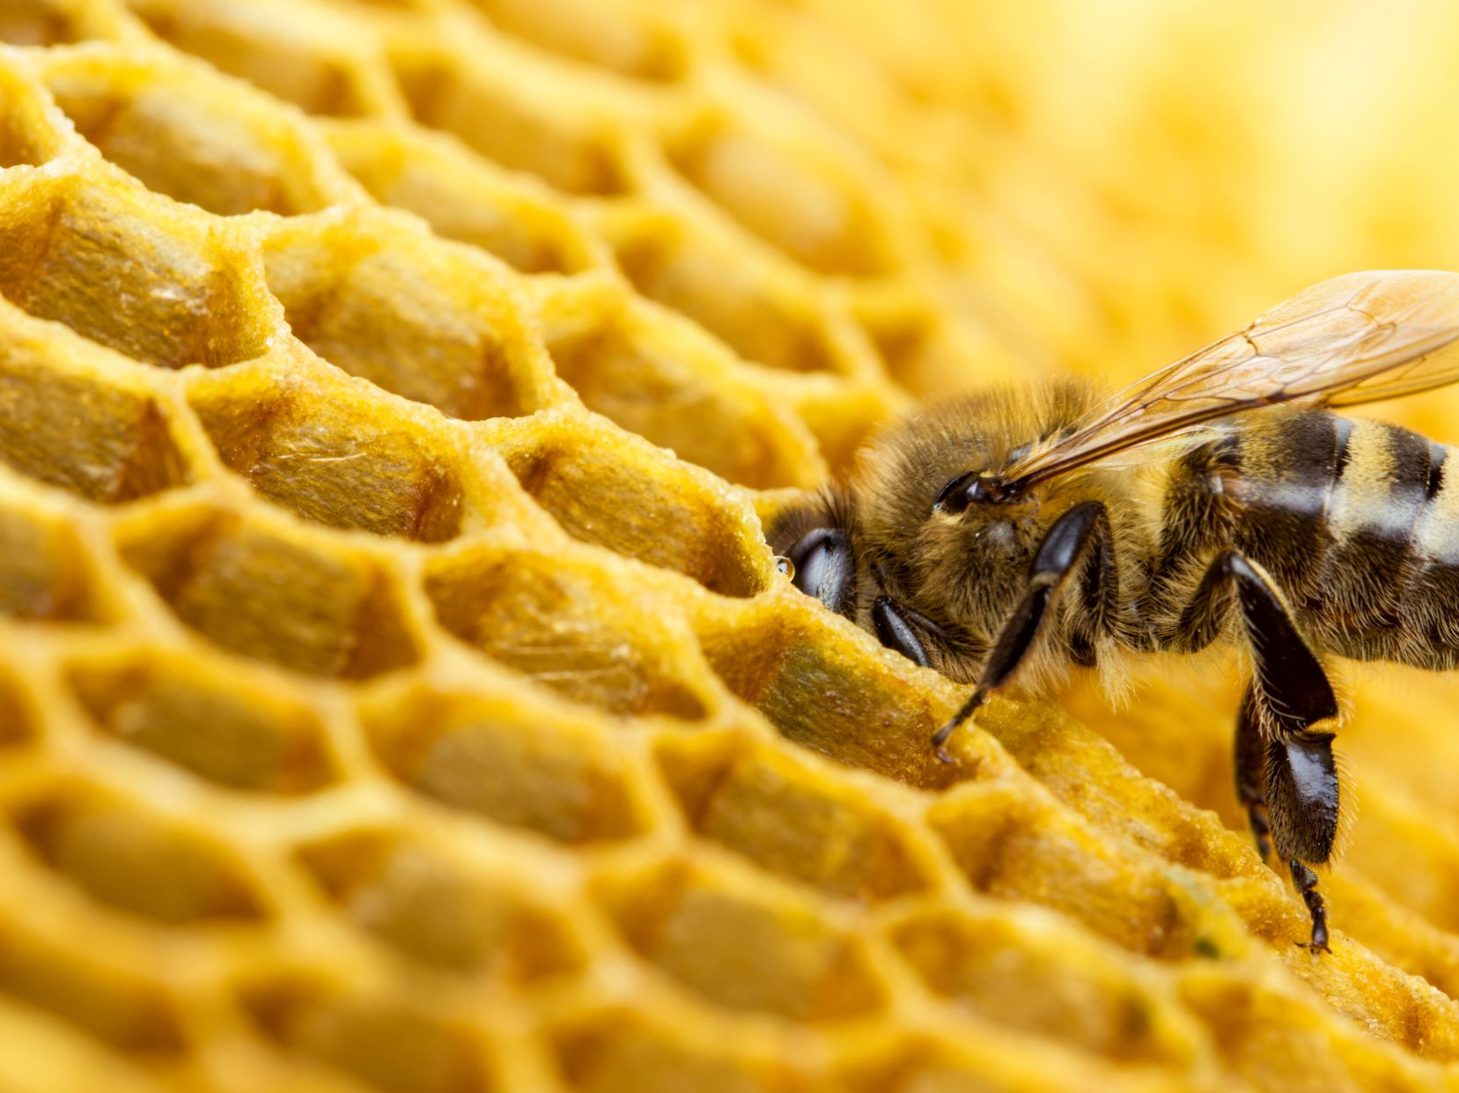
Sample strategies for... resource Development
Use the Partnership Type Reflection Tool to identify types of partnership, and if resources should be allocated differently
Invest in or advocate for a partnership coordinator
Secure financial investment or in-kind resources from each partner

Slide 12
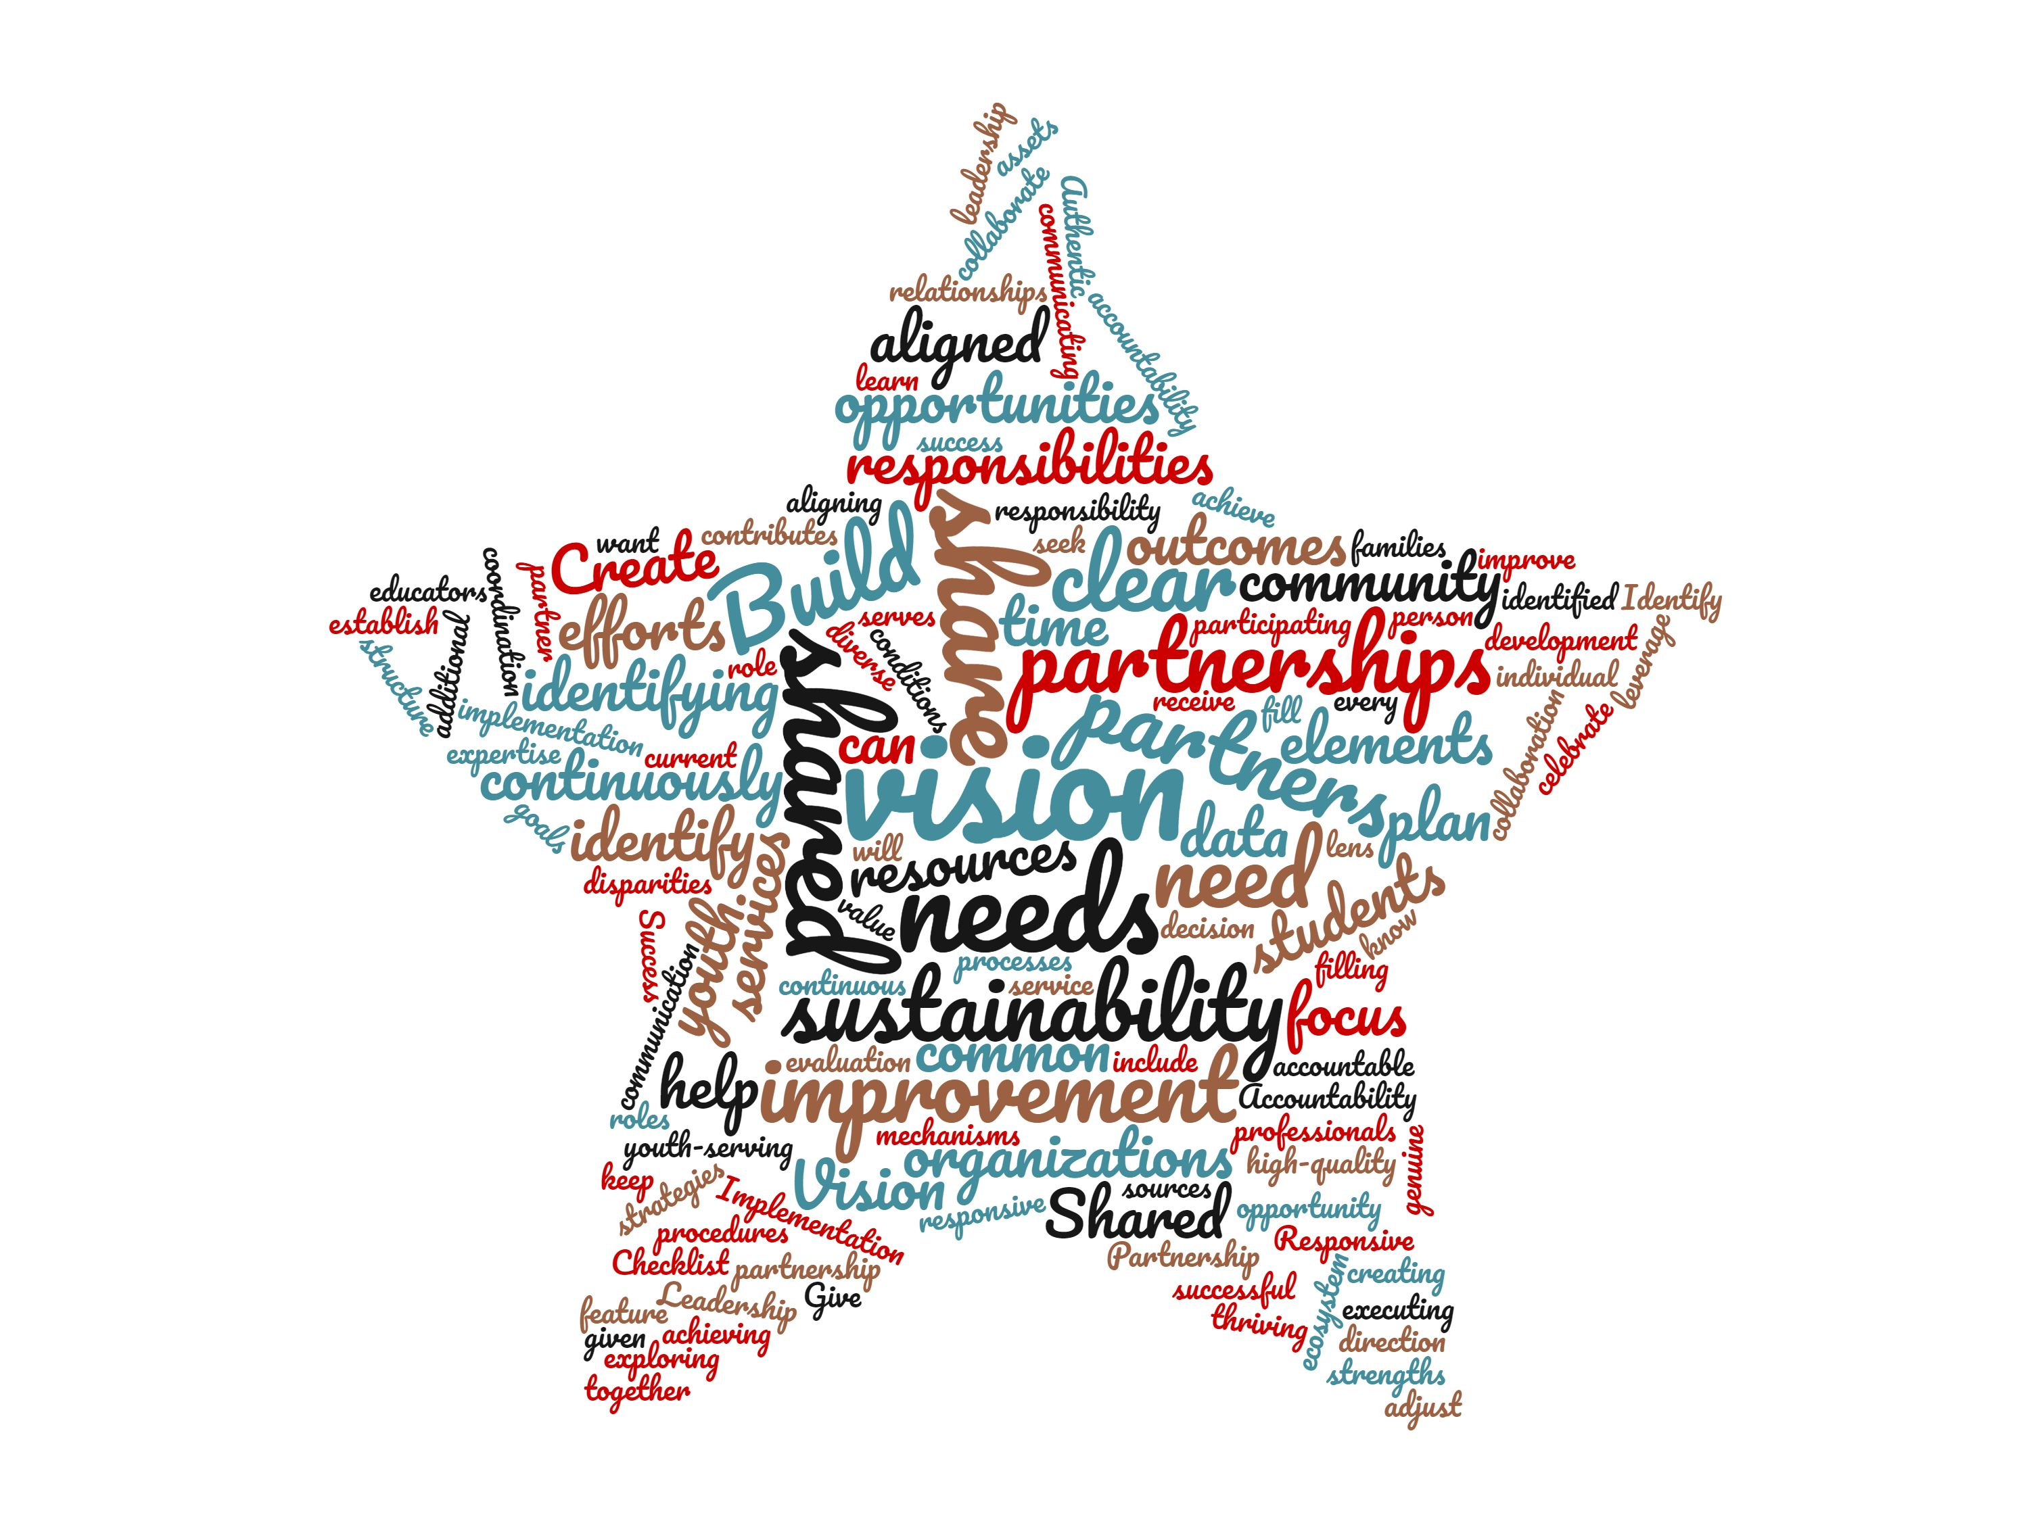
Built to Last: Practices & Tools
What do we need to do in this domain to build sustainable partnerships in our current context?
What does it look like to infuse equity into our practices in this domain?
Word art by YDEKC.

Slide 13
What relationships have you built?
How do you communicate with stakeholders— and what about?
What has been documented, and how?
What does your cycle of continuous improvement look like?
What resources are in place to sustain the partnership?
Assessing your program & Partnership

Slide 14

Reflection & Goal-Setting
What's one goal you are setting for yourself in a growth area, and an action you will take towards that goal?

Slide 15
Keep in contact
Name of Trainer, Email address
Complete the survey!
Resource Credit: Youth Development Executives of King County School & Community Partnership Toolkit & Curriculum

