Slide 1
Communication and feedback practices to strengthen cross-sector partnership
Notes:
What needs to happen next:
- making the changes from virtual to in person (do during 10/5 meeting)
- list of materials needed
- Anne to put together PDF/Slide of strategies from past sessions
- add slides and graphics for missing sessions (10/5)
- update the outline (10/5)
- decide who's doing/leading what parts (after 10/5 meeting)
- Practice session in person on 10/21 @ office

Slide 2

Welcome to "Communication and feedback practices to strengthen cross-sector partnership"!
As you arrive, we welcome you to...
Say hello in the Chat Box
Get grounded by acknowledging the land you're on
Prepare for our Community Building activity by reflecting on this question: What is some positive recognition for a partner or something to celebrate from your partnership?
This Photo by Unknown author is licensed under CC BY-SA-NC.
Notes:
Have people in groups of 3-4 introduce selves with these prompts (~3-4 min), then whole group share out words/phrases that we write down on main whiteboard or poster.

Slide 3

School & Community Partnership Toolkit – Communication tools
Feedback Loop Exercise
Planning for Ongoing Communication
Tip Sheet: Planning for Equitable Meetings
Sample Partnership Check-in Agenda & Meeting Topics
Elevator Pitch Activity
Image: Clckr-Free-Vector Images (Pixabay)
Communication Strategy Guiding Questions
Youth Program Partnership Newsletter Guide

Slide 4
Learning Objectives
Identify
Learn
Learn ways to build a culture of open and effective communication within partnership
Identify tools to support trust-building, continuous improvement, and accountability

Slide 5
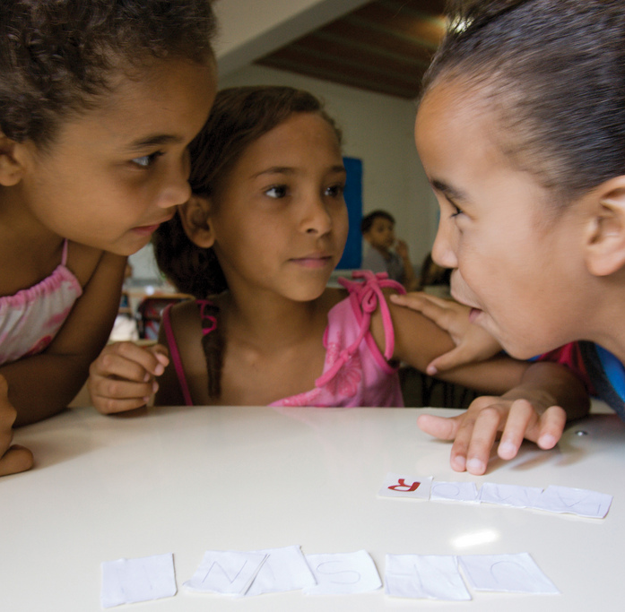
Setting the stage
Learn with and from each other
Participate in activity & discussion (Let us know if your circumstances require that you to be a passive participant)
Cameras on when possible
Offer grace
Use "raise your hand" feature or "unmute" to speak
Contribute ideas or questions in the chat box
Low-tech – Have a writing utensil and pieces of paper near you for activities during today's session.
This Photo by Unknown author is licensed under CC BY-SA-NC.
Notes:
Change to in person norms, housekeeping. Kelly and Kintasha to update.

Slide 6
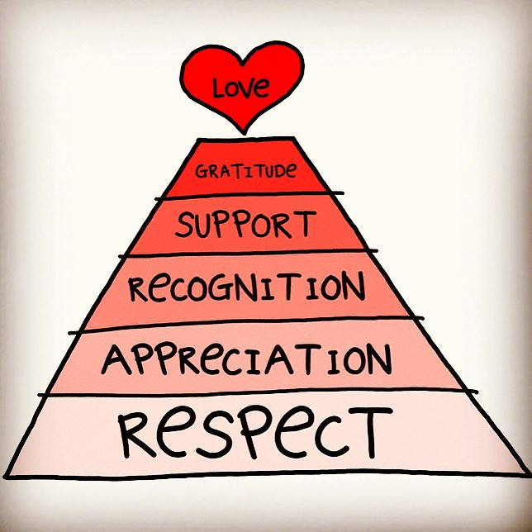
Give some positive recognition to a partner to share something to celebrate from your partnership.
Bonus: Share a story that relates to communication!
Example:
"My colleague recently put up a Wall of Fame in the staff office and I've noticed how we make sure everyone in the partnership receives individual recognition."
This Photo by Unknown author is licensed under CC BY.
STRENGTHS-BASED APPROACH
Notes:
Show video from Nate.

Slide 7
Partnership types
Independent/Other
Partners operating “side by side.” They may recognize each other’s value but mostly “stay out of each other’s business.”
Collaborative
Partners working jointly together on a program or programs towards a shared goal. Partners recognize that all have an important role to play in supporting youth.
Integrated
Partners that work together to set goals, make decisions, and evaluate shared programs and their partnership.
Cooperative
Relationship is typically transactional, such as an exchange of resources.

Slide 8
Sample communication focus and practices within partnership types
Independent/Other
Communication focused on partnership set-up and end-of-program/cycle. Each organization decides how and what to communicate.
Collaborative
Communication around shared goals, meeting community needs. Explicit agreements around communications – e.g. meeting frequency. Contribute to each other's public communications.
Integrated
Regular communication is integral to the partnership and program activities and outcomes, from visioning to evaluation. Relational communication practices, such as shared decision-making and twice monthly meetings. Have a process for conflict resolution and problem-solving as partners.
Cooperative
Transactional communication, such as an application for space rental and email confirmation.

Slide 9

building a culture of open communication
Think of a time when someone gave you feedback that helped you learn and grow (in any setting).
Share your story in your group.
Describe the relationships or environment that enabled you to respond to the feedback.

Slide 10
Cultivating conditions
Self & social awareness - Be aware of power differentials
Know your audience by building relationships
Be explicit about intentions, preferences, and expectations
Take steps to mitigate stereotype threat
Recognize strengths, contributions, and improvements on a regular basis
Model it
Structure it!
Consider relevance of time and place
Ask for specific feedback – "Name one thing I could do to improve"
Know who your allies are and when to call on them

Slide 11

Application: Feedback Touch Points
What are the current feedback touch points? What do we give/offer feedback about?
What values or practices would help us be more authentic?
What is one concrete step we will take?

Slide 12

Tools to support EFFECTIVE COMMUNICATION
Feedback Loop Exercise
Partnership Meeting Topics and Sample Agenda
Tip Sheet: Planning Equitable Collaboration Meetings
School-Community Partnership Design and Planning Tool
This Photo by Unknown author is licensed under CC BY-SA-NC.

Slide 13
Self-assessment
Choose a number:
I want to strengthen communication through giving and receiving feedback.
I want to plan meaningful and productive partnership meetings.
I want to create conditions for more equitable collaboration with my partners.
I want to communicate effectively when reviewing, revising, or designing a partnership.

Slide 14

Breakout rooms: Discuss the tool
What?
  What is it for?
  Do you have an example of what this looks like in action?
So what?
  What's important about this tool?
Now what?
  How might you apply this tool?
Be prepared to share 1 useful thing your group learned.
This Photo by Unknown author is licensed under CC BY-ND.

Slide 15

Reflection
Share:
One action and...
One appreciation
This Photo by Unknown author is licensed under CC BY.

Slide 16
Keep in contact
Name of Trainer, Email address
Complete the survey!
Resource Credit: Youth Development Executives of King County School & Community Partnership Toolkit & Curriculum

