Slide 1








Slide 2
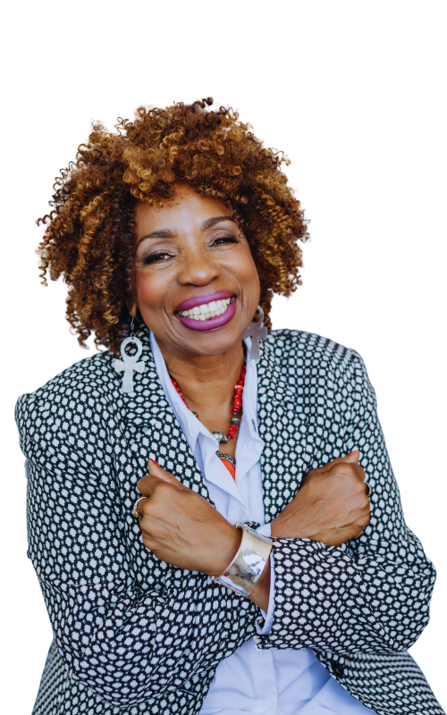
Opening Keynote
Melannie Denise Cunningham
The Peace Queen

Slide 3

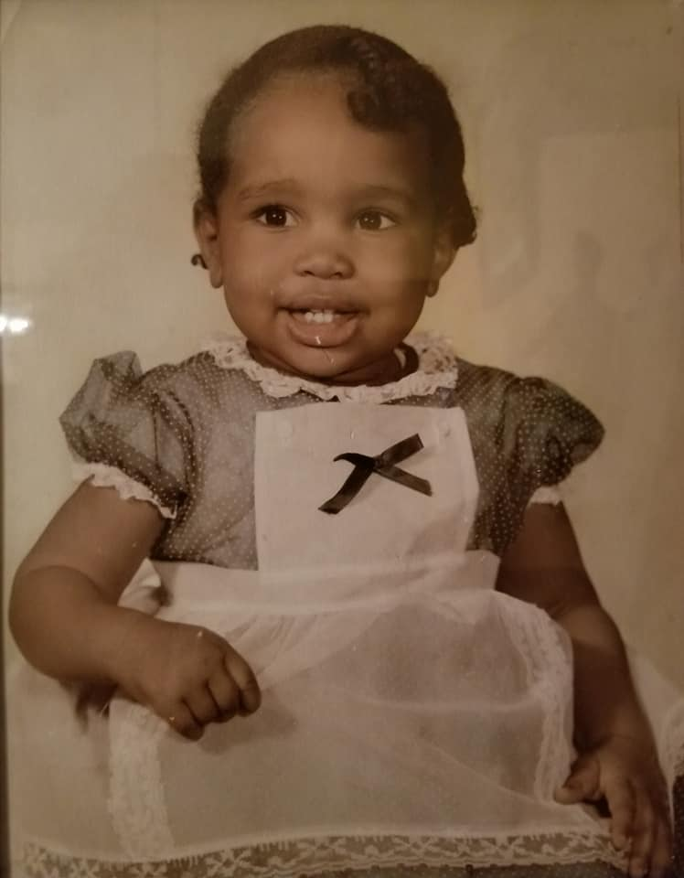
MISS
MELANNIE
Opening Speaker

Slide 4








Slide 5


Reflect.
Be STILL and know.
Take a moment for introspection. Reflect on your journey as educators, the challenges you’ve faced, and the milestones you’ve achieved. Reflect on your own beliefs, biases, and experiences.

Slide 6

Connect.
Where are you rooted?
Examine your network of connections and the depth of them with students, families and colleagues?

Slide 7

Reimagine.
How can we best align our educational and youth service efforts to ensure that every young person not only succeeds academically but also thrives emotionally, socially, and in their life beyond school?
Personalized Learning. Inclusive Education. Digital Learning. Collaboration. Mental Health and Wellness. Parent and Community Involvement. Project-Based Learning. Cross-Disciplinary Education. Career Readiness. Data-Driven Decision-Making.

Slide 8

Gardening as a Metaphor For Change
SOIL – Seek to understand how standard policies and practices influence and impact your learning environment and service delivery.
SEED – Prepare yourself for long term growth by engaging in self-assessment and inner work.
ROOTS – Build racial competency and understanding.
SPROUT – Acknowledge and appreciate small beginnings and early growth – in your personal life and in your spheres of influence.

Slide 9
Gardening as a Metaphor For Change
CONTINUED
BUD – Create and share the vision with others, set a collective precedent, and establish direction.
WEED – Uproot beliefs, practices, and policies that work against cultivating the justice and belonging we all deserve
BLOOM – Begin to ask, ‘What do I do next?’ as you continue to build on what you have cultivated. Repeat the growth process.

Slide 10
YES WE
CAN, CAN!
Announcements

Slide 11

THANK YOU!
Melannie Denise Cunningham
info@thecunnighamnetwork.com

